Slide 1


INSTITUTE FOR ADVANCED COMPUTING AND SOFTWARE DEVELOPMENT AKURDI, PUNE
Power Point Presentation on
“Online Shopping Mart”
PG-DAC MARCH 2023
Submitted By:
Group No:
109
Name : PRN:
Mohit Bijwar (233051) 230341220100
Rushikesh Mohite (233075) 230341220150

Slide 2
Introduction
The purpose of this SRS is to provide a clear, documented model of the requirements for
E-Commerce online shopping website. This document serves to provide top level use cases for a web customer making purchases online. The OSM (Online shopping system) system includes the Customer subsystem as well the Seller subsystem.
The OSM provides a platform for conducting sales of a wide variety of goods across the globe. It is implemented as an internet-based enterprise and has a vast inventory of products from books, houseware, electronics, groceries and much more. Sellers use this system to easily expand their service to a more global platform. This guarantees better flexibility, larger audience and an improved market. The appeal of OSM experienced a large boost in the last decade because the customers can browse easily through various options, brands and price ranges with very little hassle. The ability to reap its benefits from the comfort of one’s own home has only bolstered its claim as one of the biggest enterprises that dominates the internet. This project is an attempt to provide the advantage of online shopping to customer of physical store. It helps buying the products in the shop anywhere through internet by using a smart phone, computer. Thus, the customer will get the service of online shopping and home delivery from their favourite shop through E-Commerce OSM.

Slide 3
Objective
The objective of the project is to make an E-commerce web application in to purchase items in an existing shop. In order to build such an application complete web support, need to be provided. A complete and efficient web application which can provide the online shopping experience is the basic objective of the project. The web application can be implemented in the form of an e-commerce application with web view.

Slide 4
Scope
The E-Commerce OSM provides a platform for conducting sales of a wide variety of goods and provides a way of bringing sellers and customers on an online platform to conduct transactions in a secure manner across the globe. It is implemented as an online enterprise. This system provides an avenue for customers to shop from a wide variety of products online. It also provides sellers a platform where they can upload their listing to the system for customers to view and purchase. The biggest advantages of the service is the comfort it brings with remote usage. The ability to compare various price ranges, brands and even customer reviews and experiences provides for a more honest/depth understanding of the product. It also provides a platform for retailers and sellers to reach a global audience.
Fitted with recommendation models to analyse customer interests, previous purchases and ratings can help recommend other products that the customer may like. This model is essential to increase visibility of useful products to the customer but also to boost the service’s revenue. The service also has a large database that stores customer data and history. Another important benefit provided by the service is the reviews section. The reviews section offers transparency around product performance and user experience. Not only do items have ratings given to it by users, but also detailed user reviews with an option to attach pictures of the product. This feature boosts customer trust and creates a community of customers who can engage with each other and help one another select the right products. A key feature is secure money transaction along with guaranteed and time bound product delivery.

Slide 5
Technology Used
Frontend:
React: Used for building the user interface, ensuring a responsive and intuitive user experience.
Backend:
Java Spring Boot: Employed to create the business logic layer, providing robust and efficient backend services.
Database:
MySQL: Chosen as the backend database management system for secure storage and retrieval of data.
This technology stack ensures a seamless and user-friendly Doctor's Appointment System, leveraging the strengths of each component for a comprehensive solution.

Slide 6
Software & Hardware Configuration
Compatibility:
⮚OSM could be installed on Windows server, Linux server.
⮚OSM will provide chrome browser compatible user interface.

Slide 7
Functionality
The current system for shopping is to visit the shop manually and from the available product choose the item customer want and buying the item by payment of the price of the item.
⮚It is less user-friendly.
⮚User must go to shop and select products.
⮚It is difficult to identify the required product.
⮚Description of the product limited.
⮚It is a time-consuming process
⮚Not in reach of distant users.

Slide 8
Project Diagrams
Home page
Seller login details
Seller profile page
Seller add products details form
Seller product list
Seller product updated
Seller product deleted
Customer Login Page

Slide 9
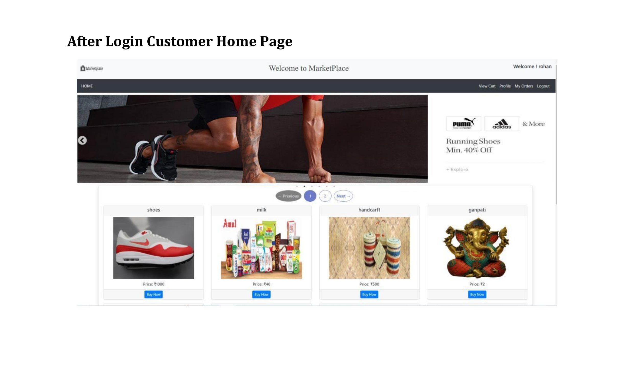

Slide 10
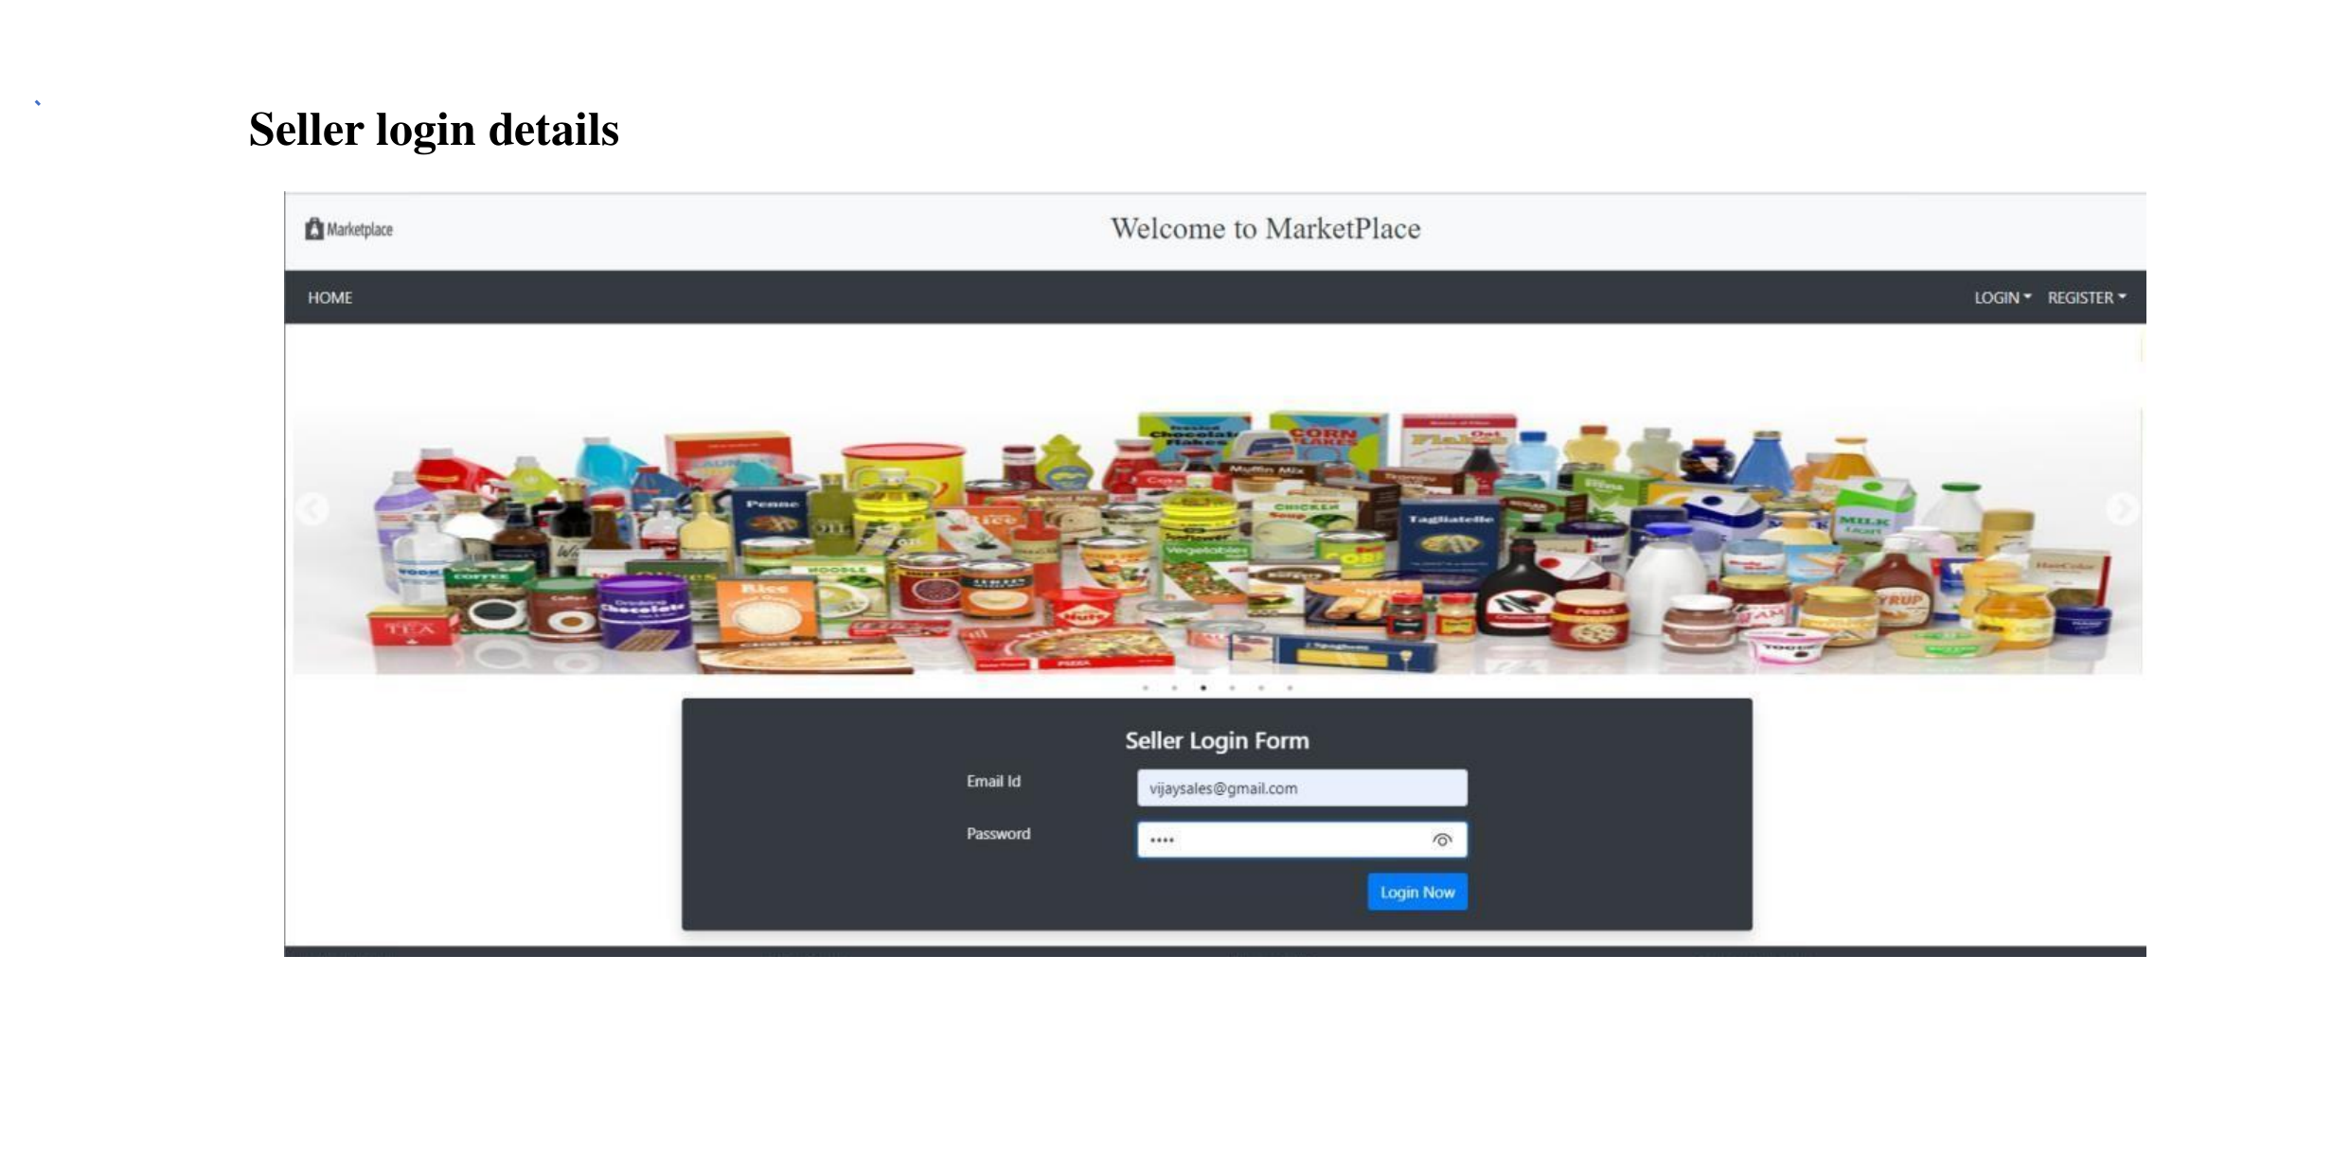

Slide 11
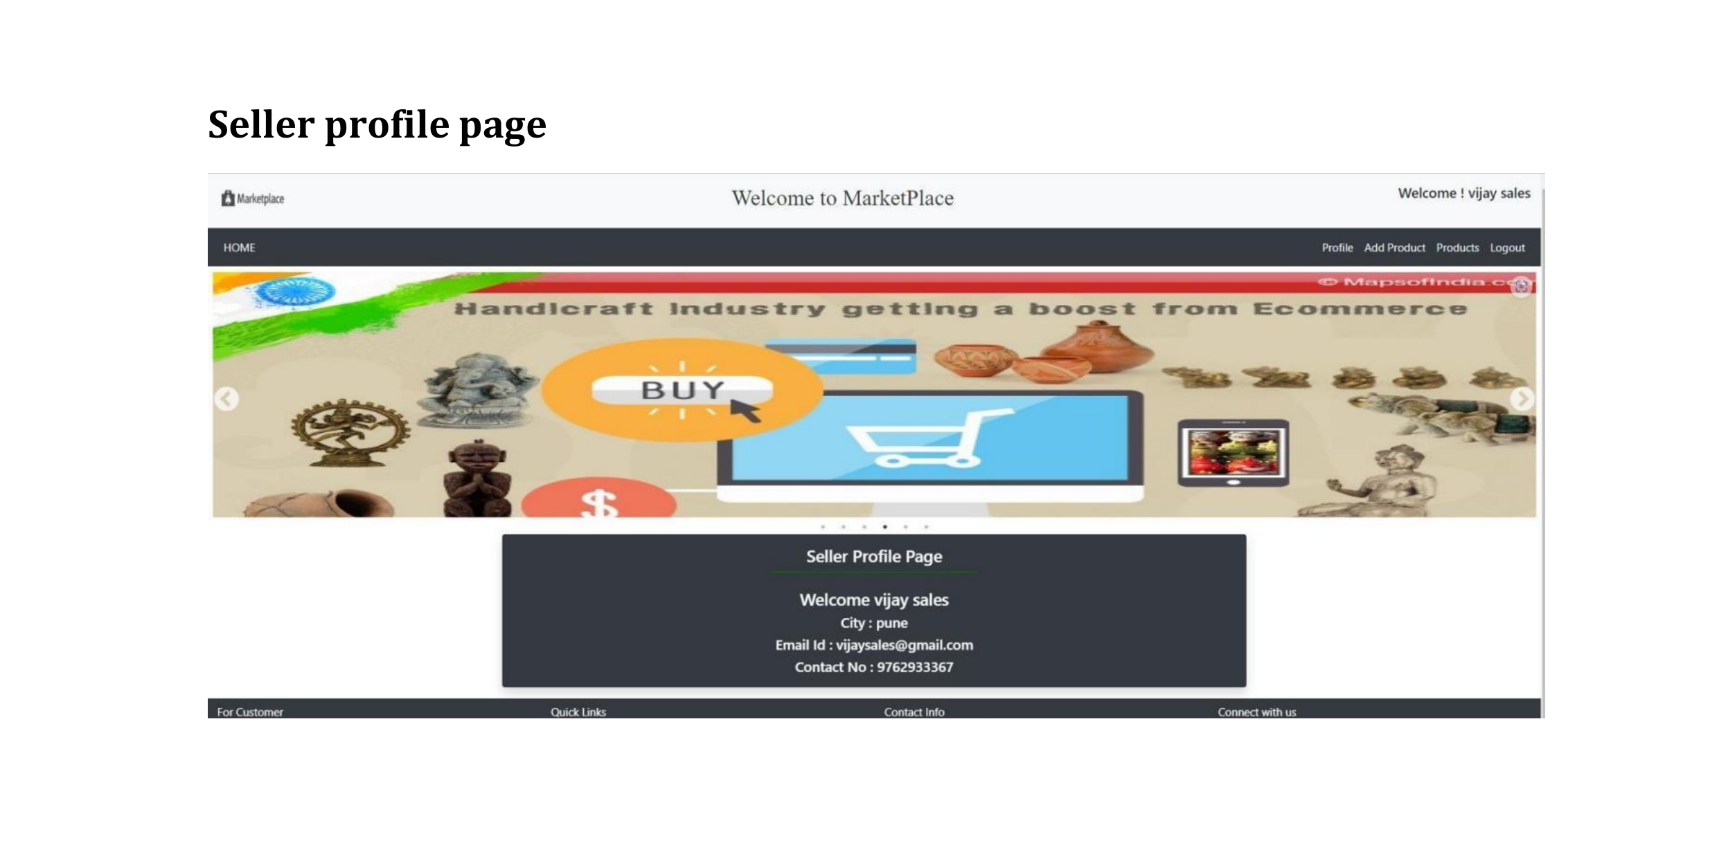

Slide 12
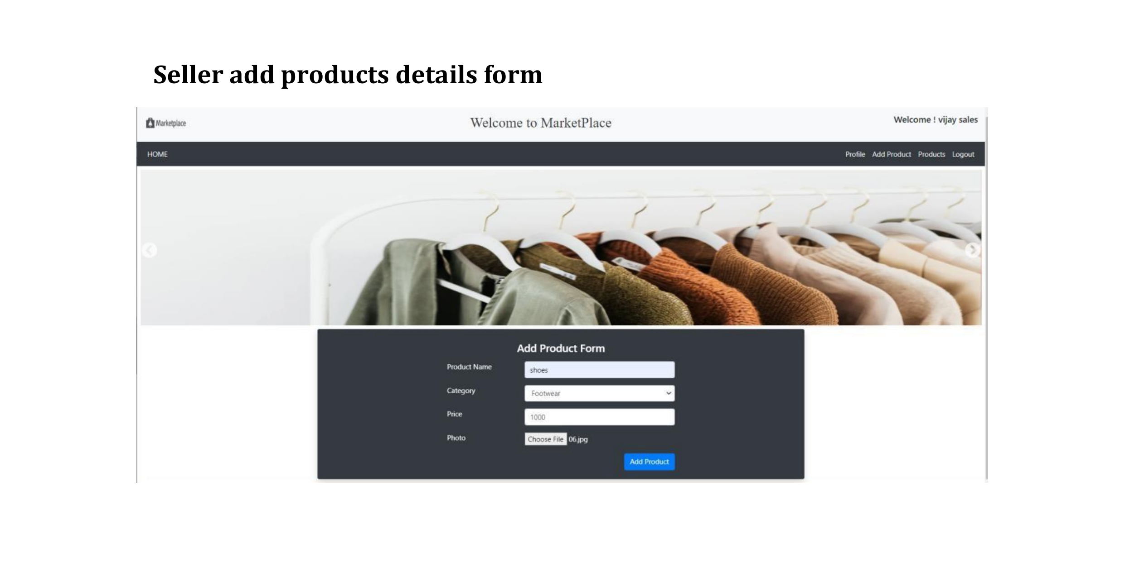

Slide 13
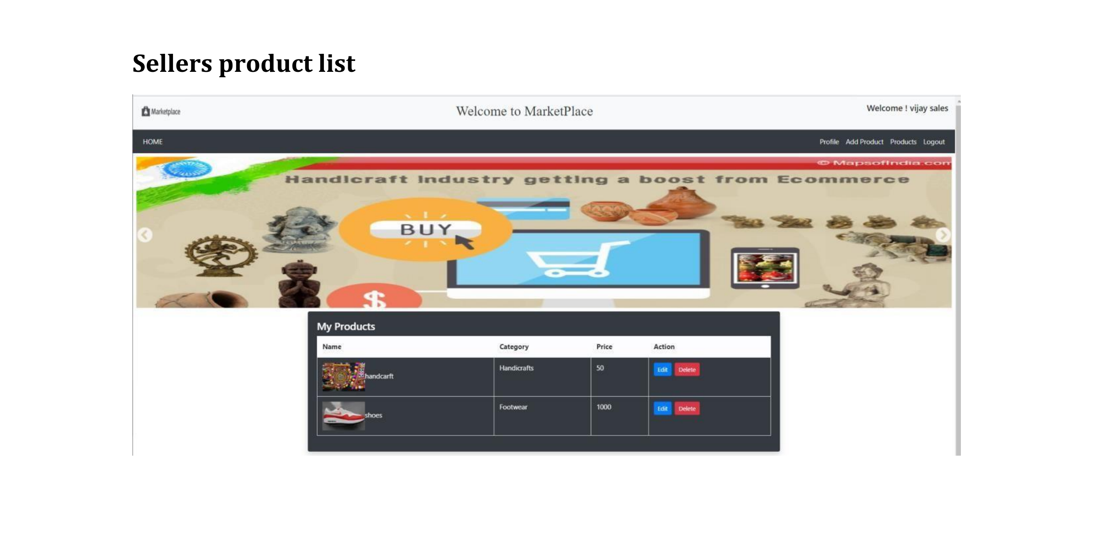

Slide 14
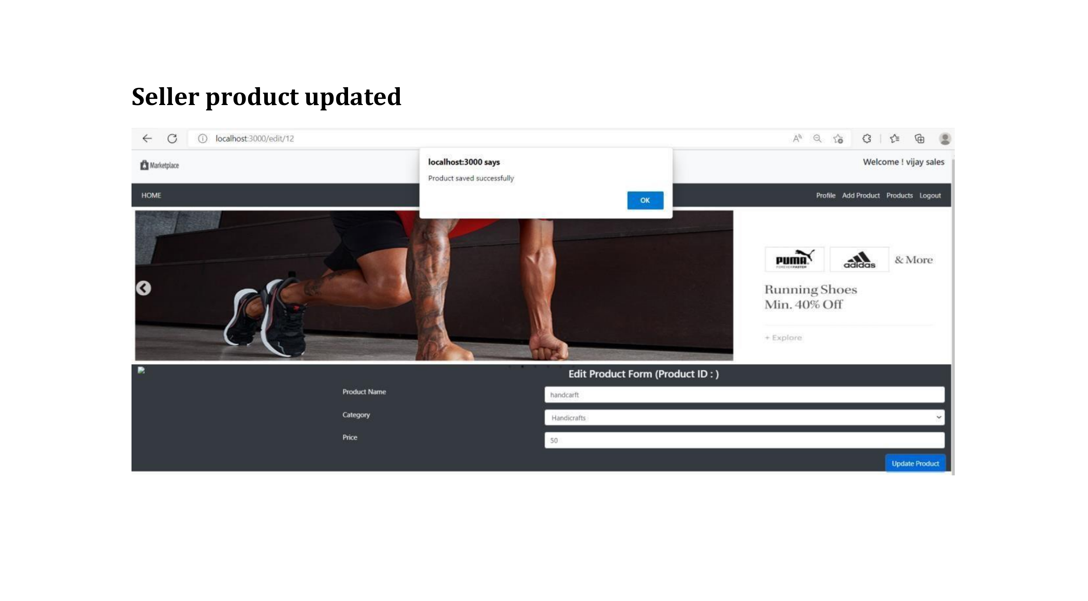

Slide 15
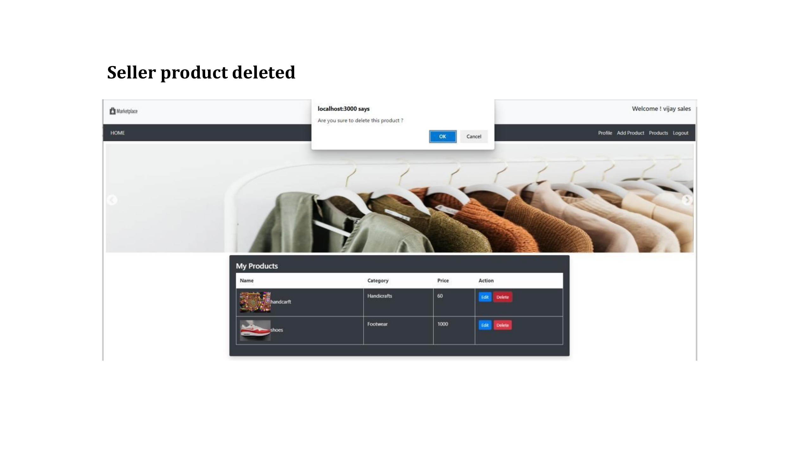

Slide 16
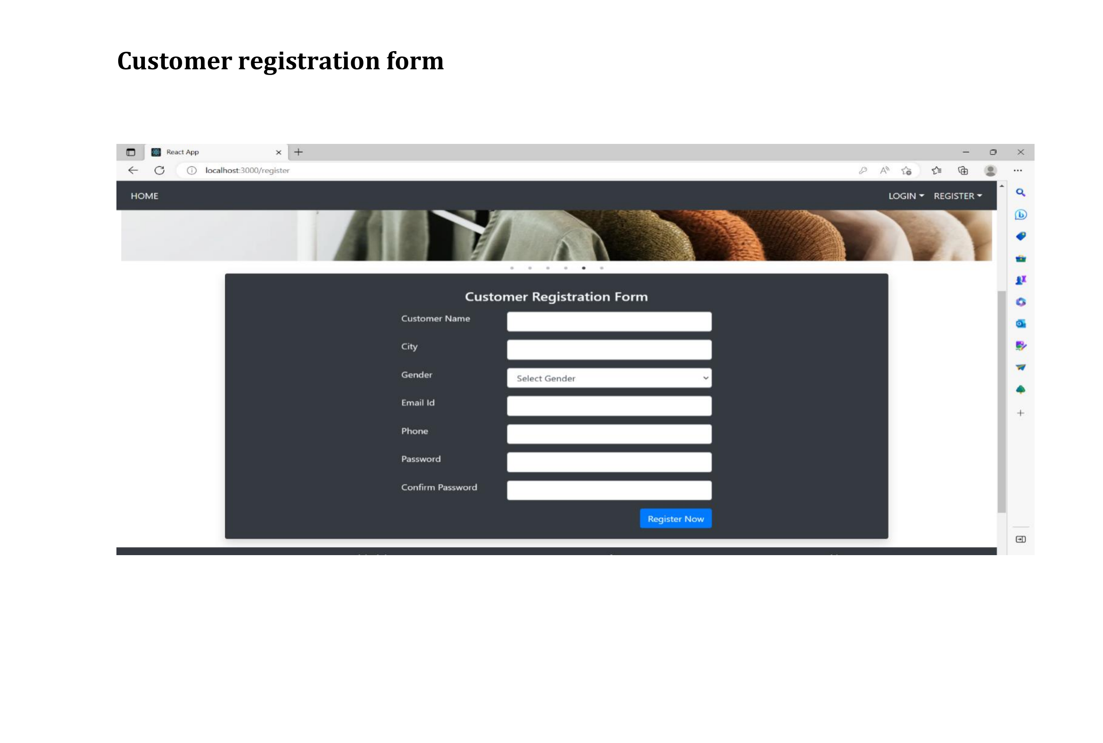

Slide 17
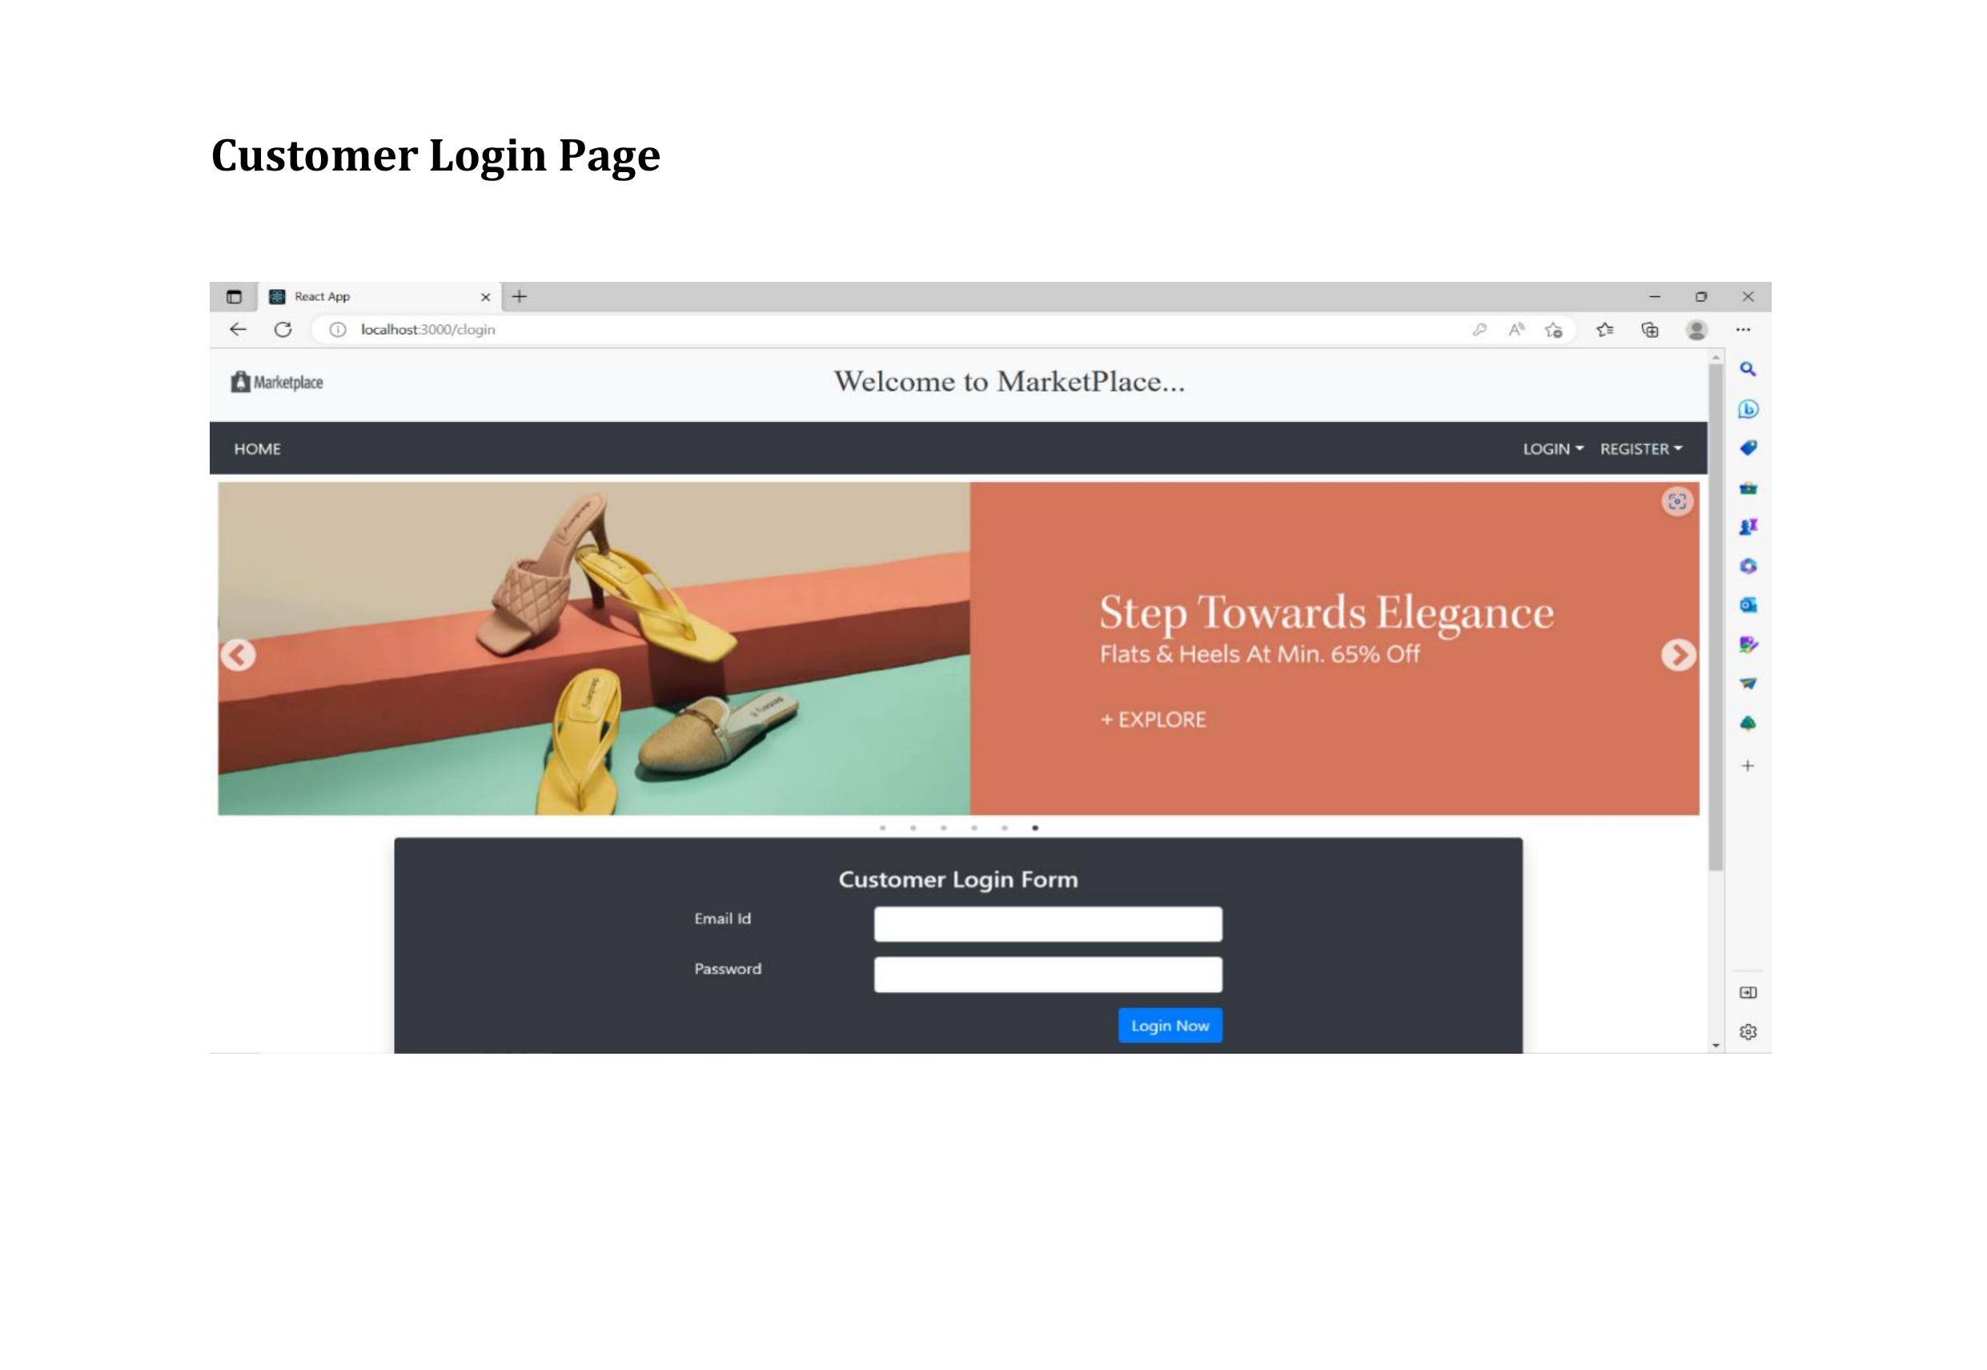

Slide 18
Project Flow
1. Admin Activity Diagram
2. Seller Activity Diagram
3. Customer Activity Diagram
4. Seller Data Flow Diagram
5.Customer Data Flow Diagram
6. E-R Diagram
7. Class Diagram

Slide 19
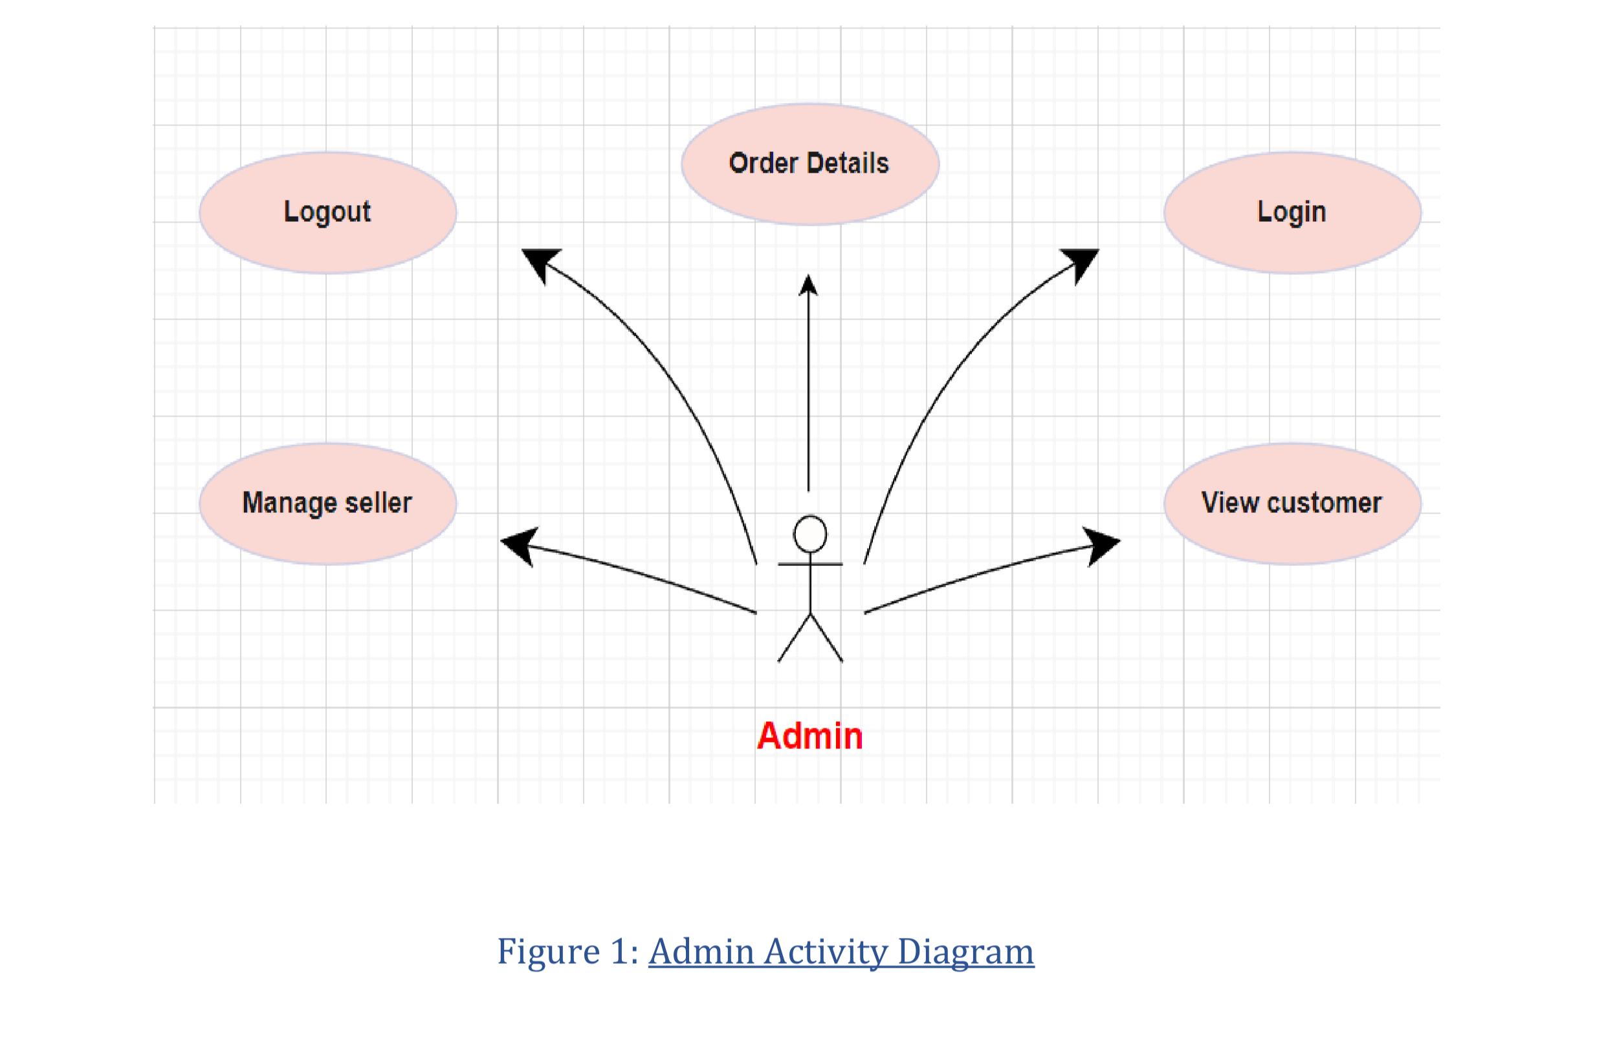

Slide 20
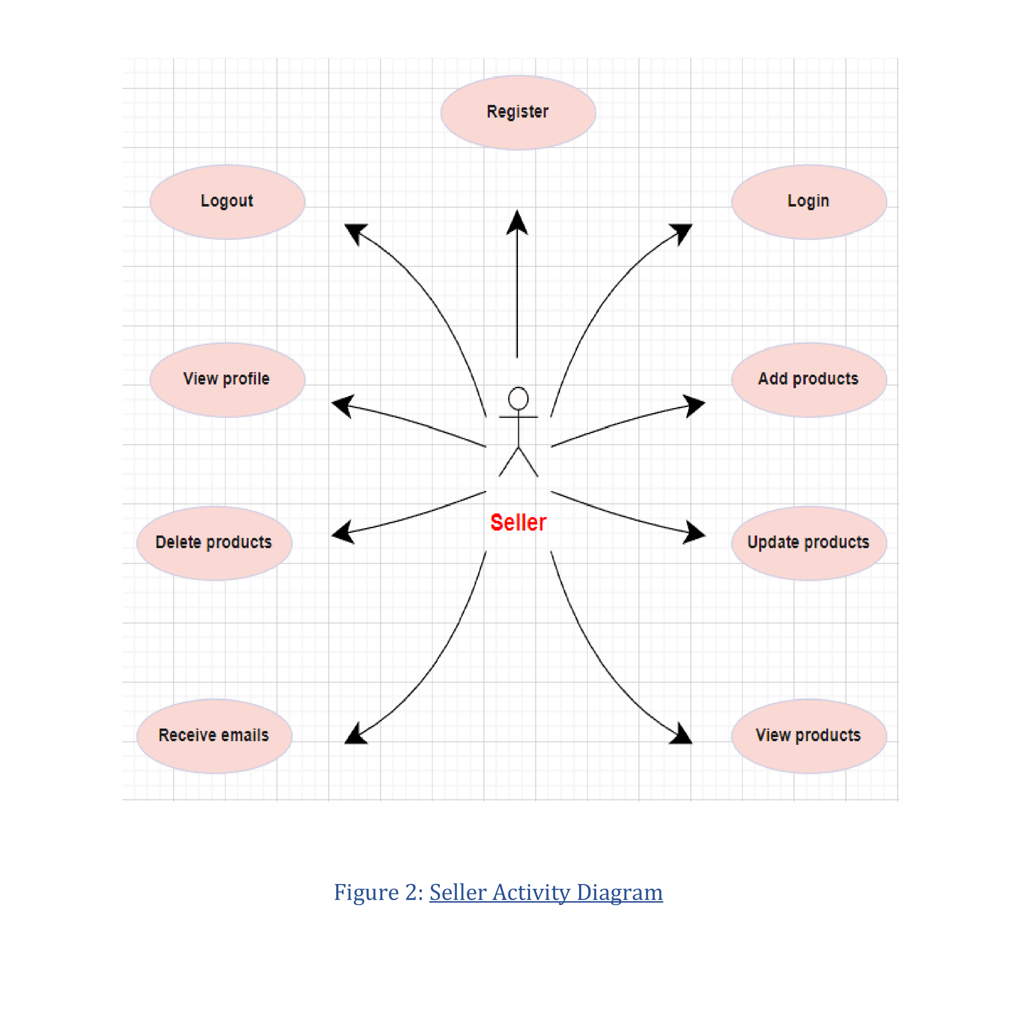

Slide 21
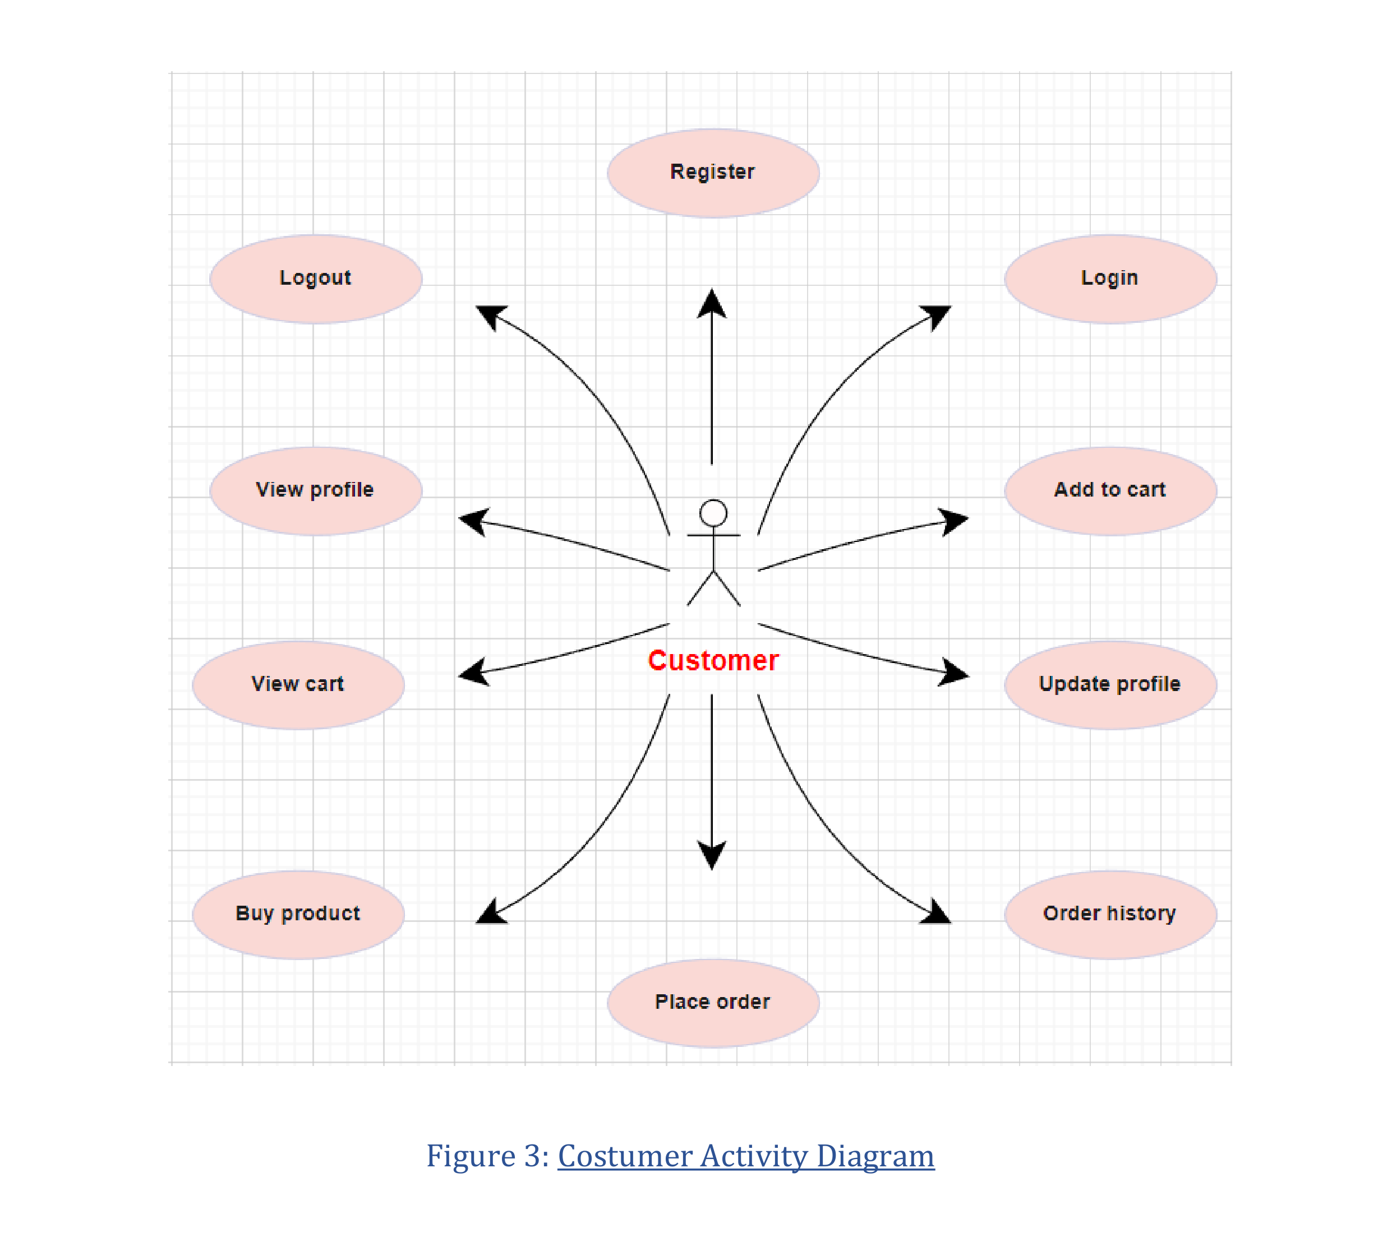

Slide 22
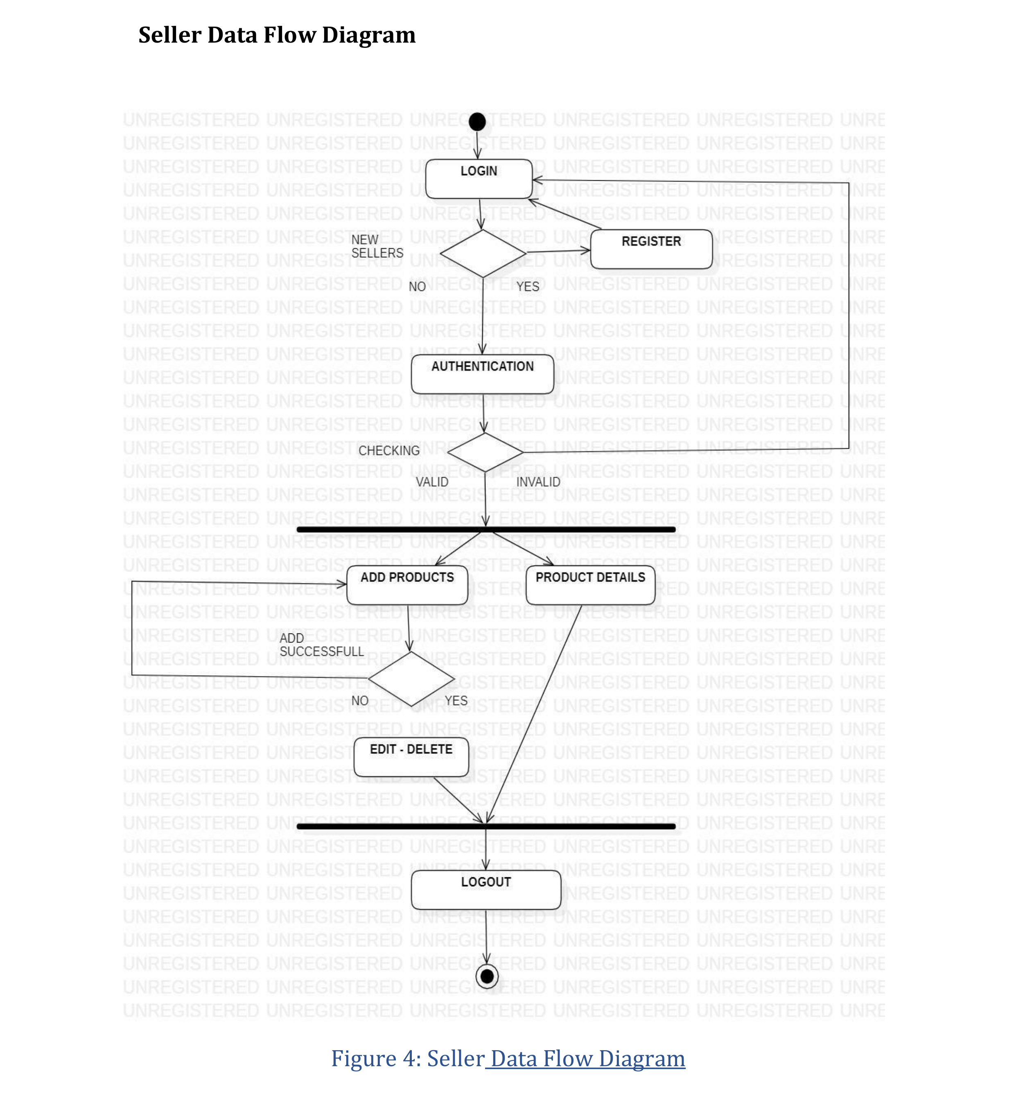

Slide 23
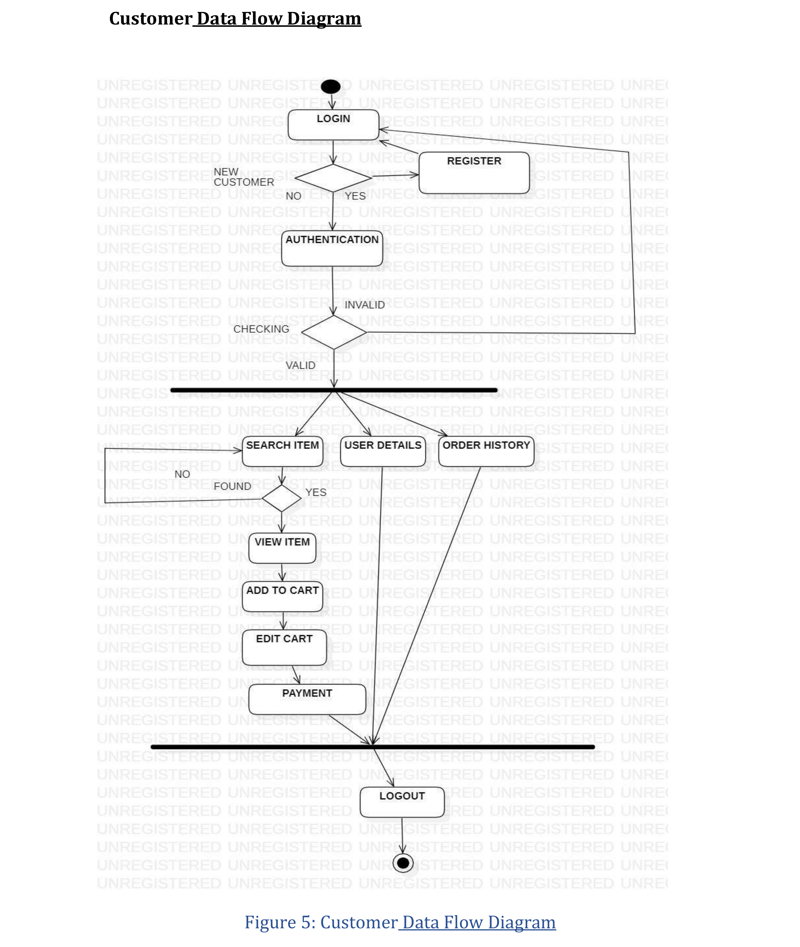

Slide 24
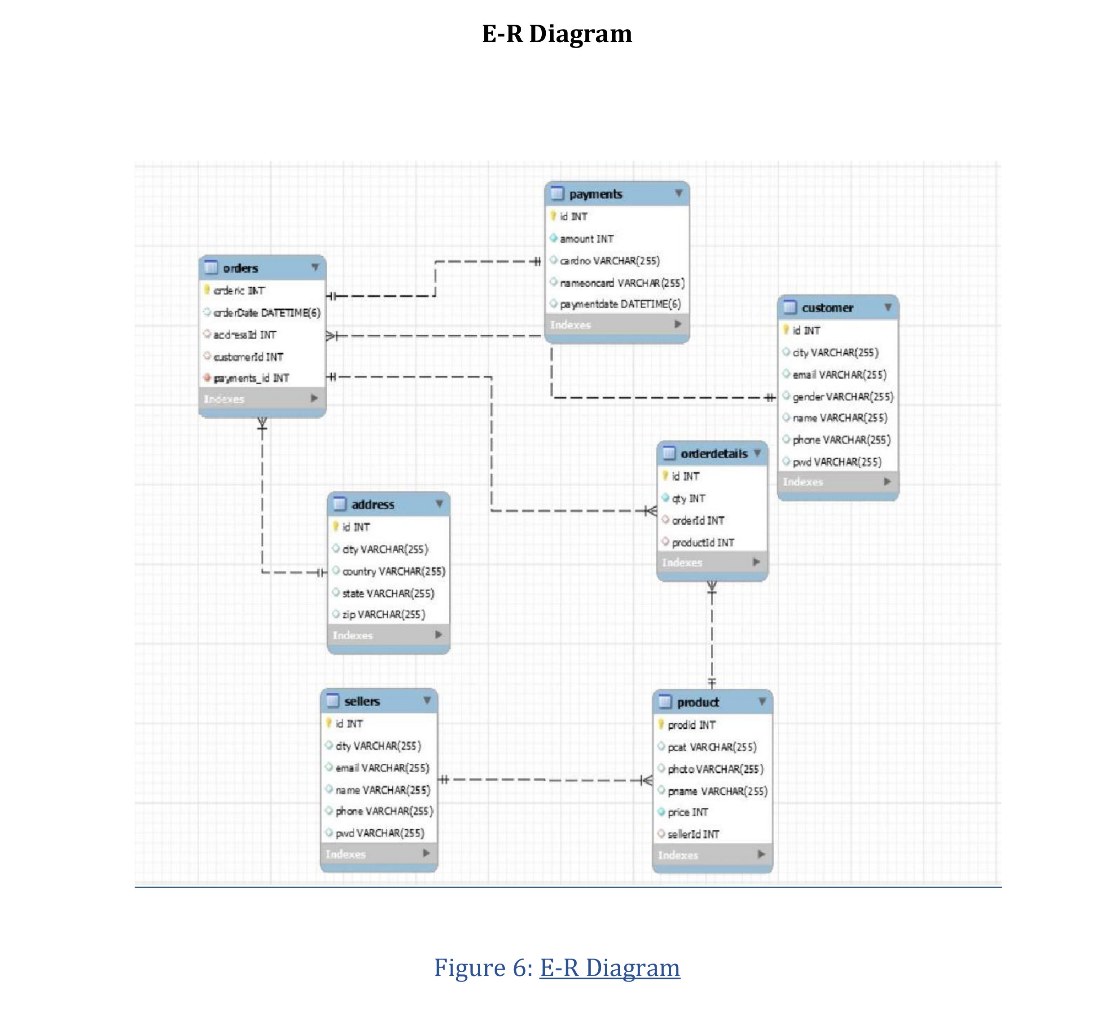

Slide 25
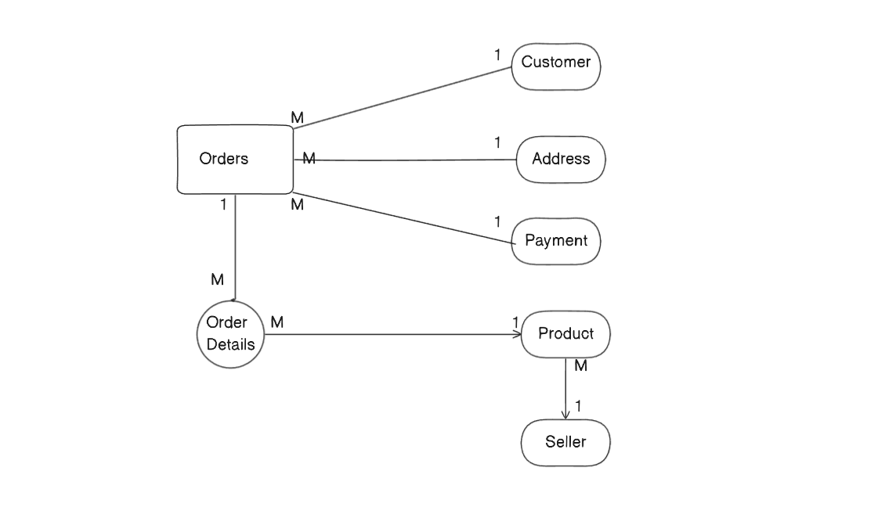
E-R Diagram

Slide 26
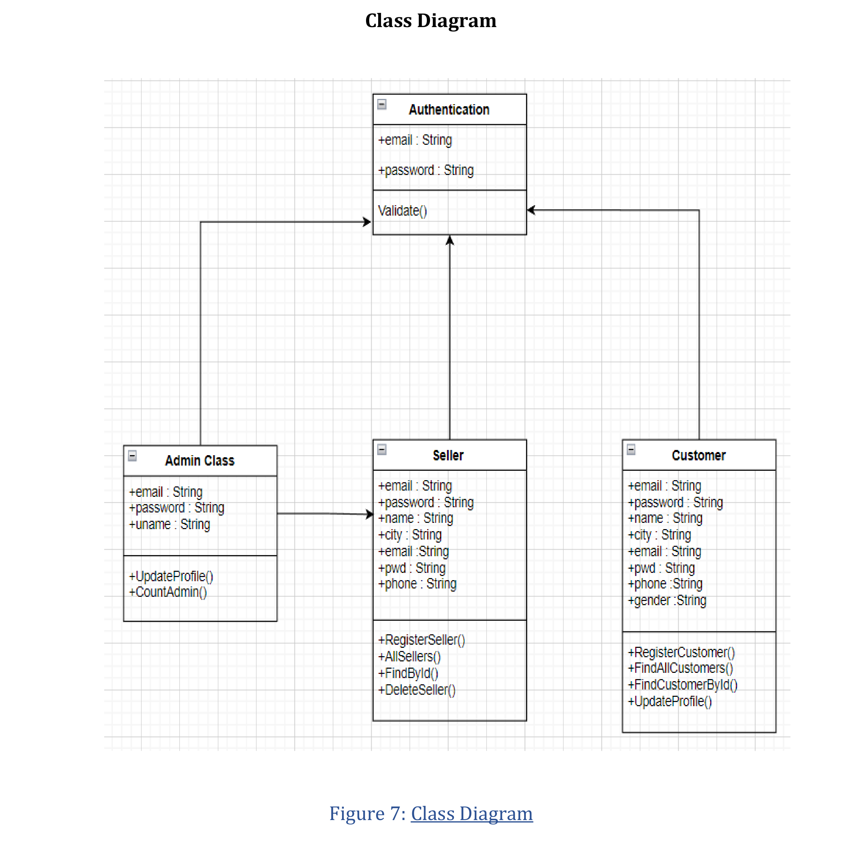

Slide 27
Thank You
.

